Slide 1
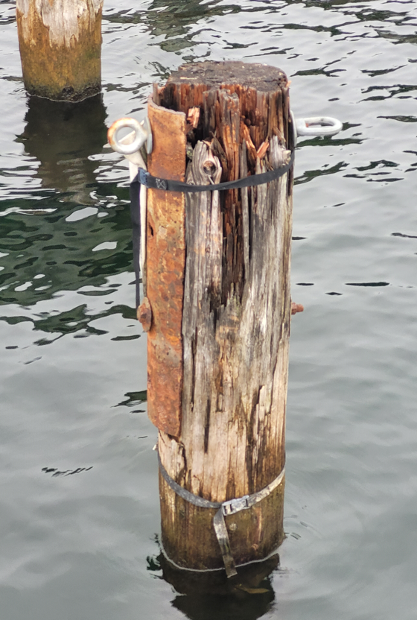
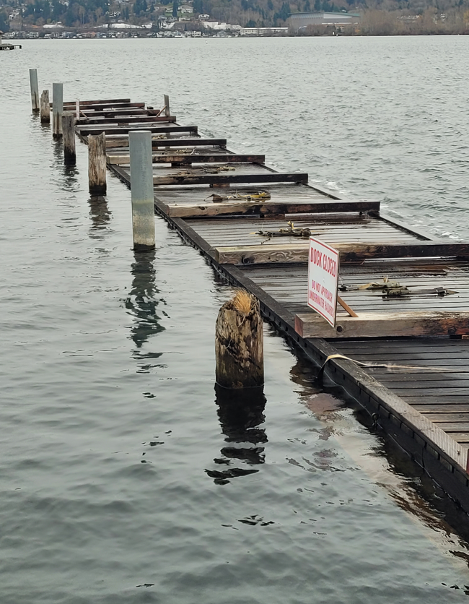
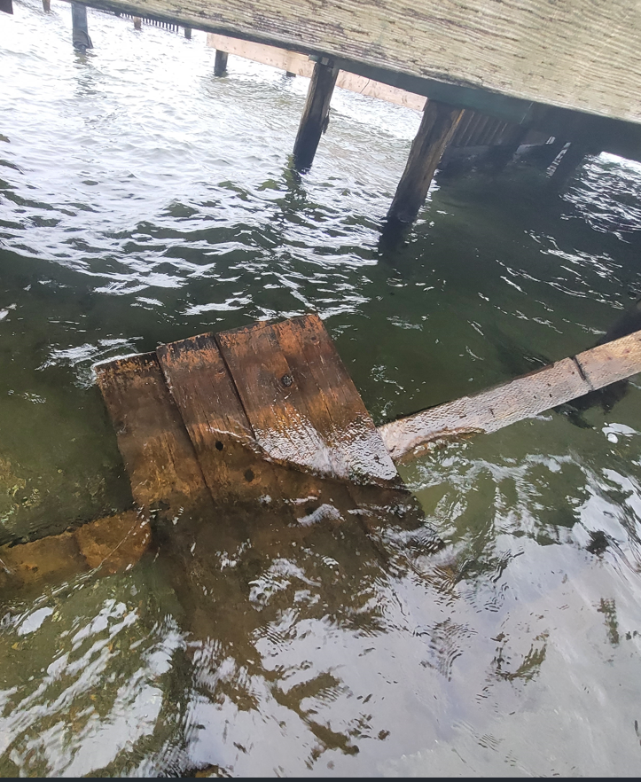
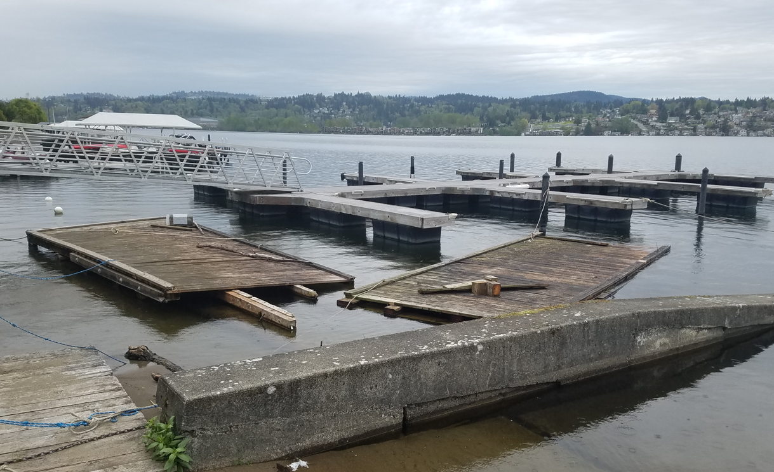
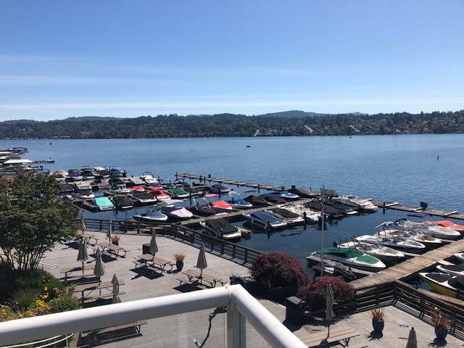
MIBC Marina Renewal
Today
Proposed
Most of the current Marina is 60+ years old.
Wooden marina is structurally at end of life.
Current design is not compliant with new City and Gov’t regulations.
Increased boat dimensions (max of 25’ long) need different slip configuration.
New Marina designed to be compliant with City and Gov’t regulations.
Solid surfaces will be replaced with light penetrating decking.
Safer design for swimmers and boaters with separation of swim dock and marina.
Same number of boat slips will be in the new marina as in current design.
No increase in number of members

